Slide 1

2022313047 김보연
파이썬을 이용한 과학계산 Final project

Slide 2
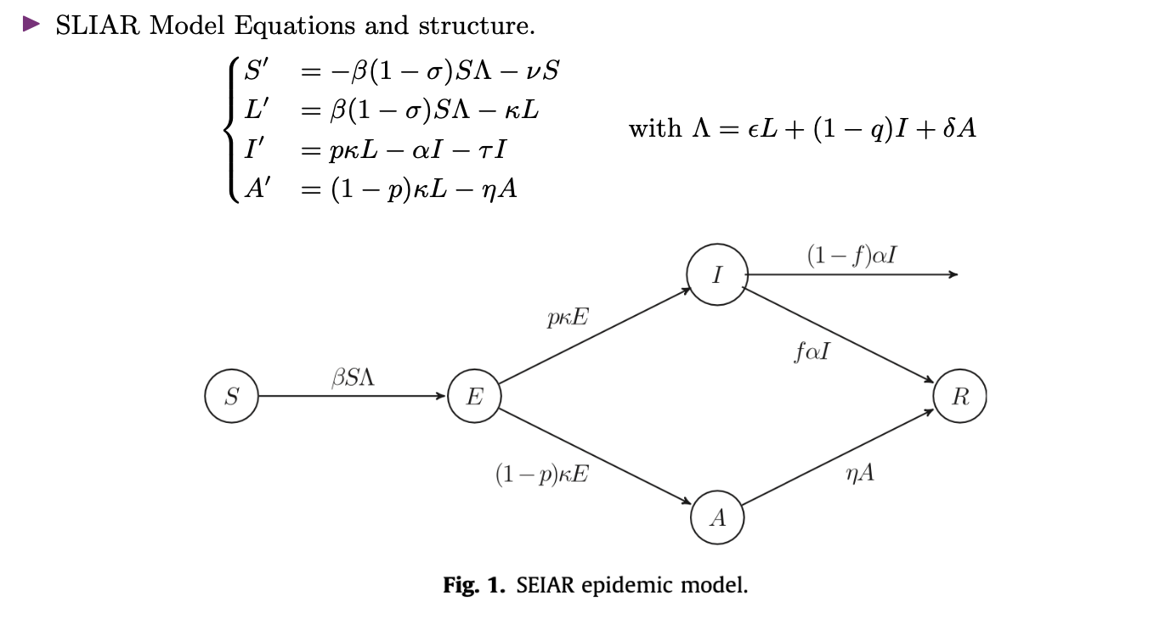
Epidemic model

Slide 3
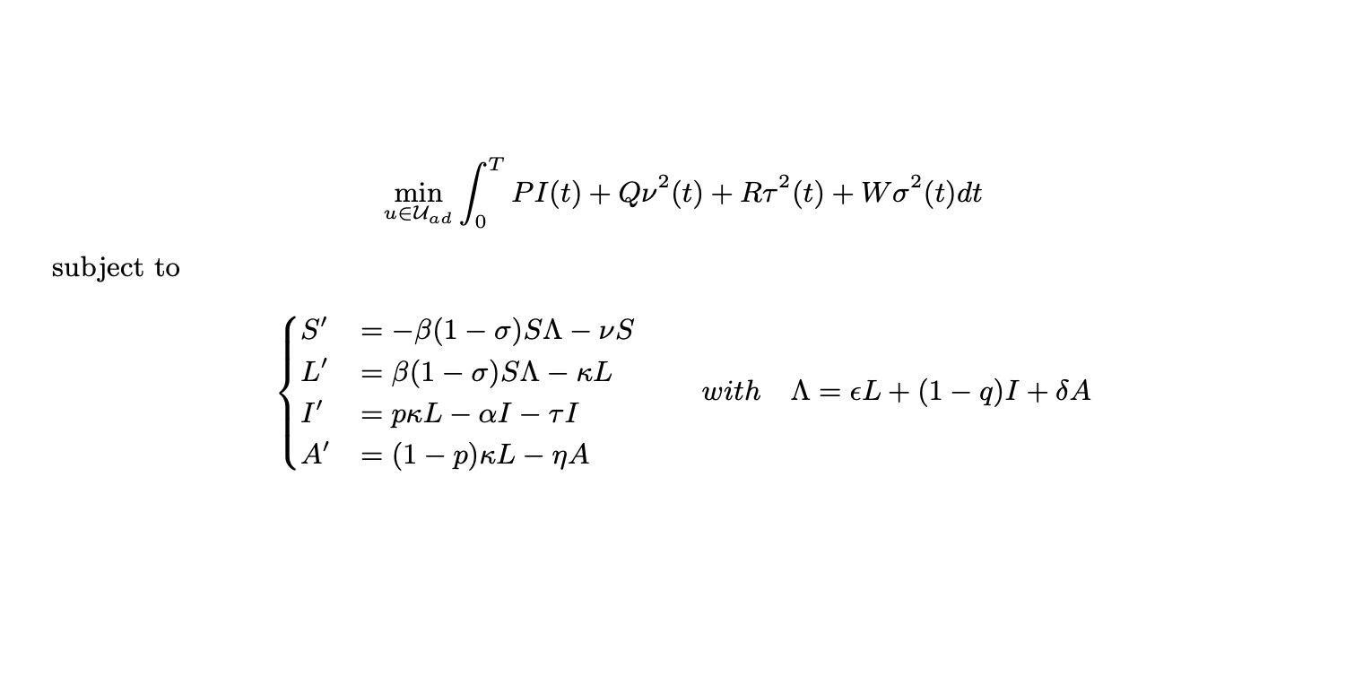

Find the optimal vaccination control to minimize given objective function
$ν:$ vaccination

Slide 4
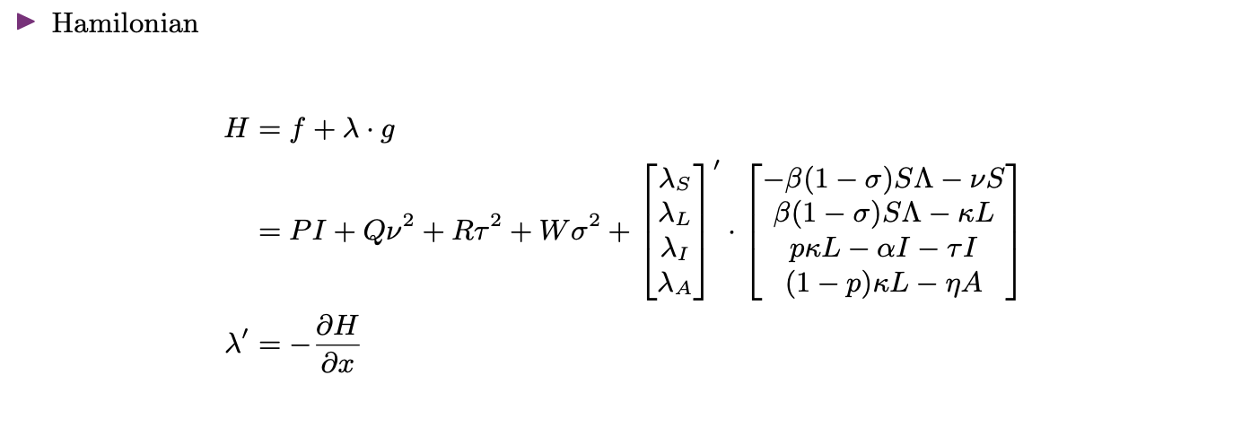
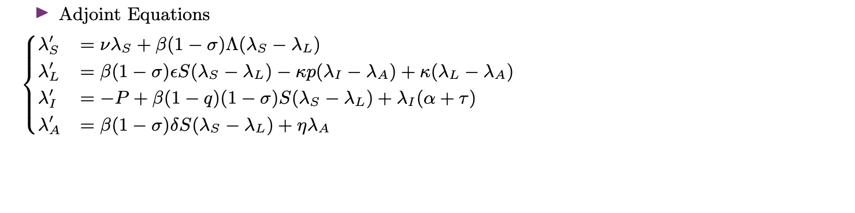
Pontryagin’s Maximum Principle

Slide 5
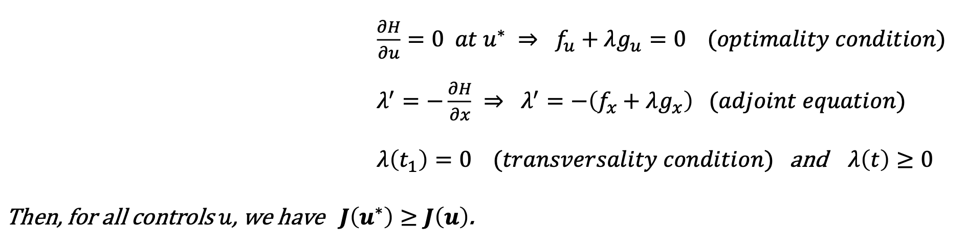
Pontryagin’s Maximum principle

Slide 6

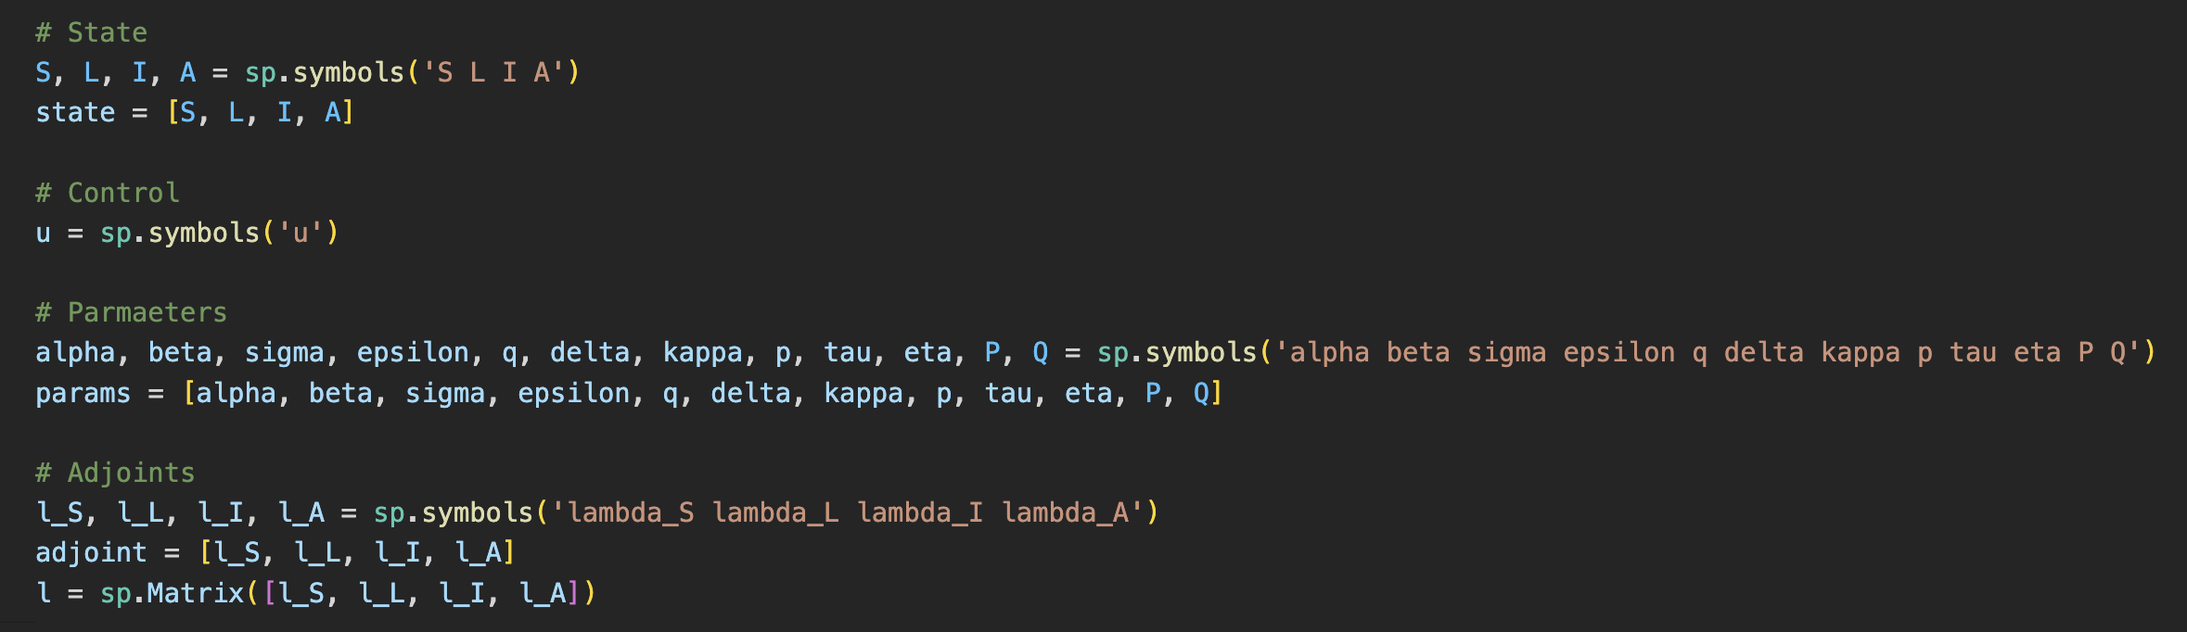
Implementation functions

Slide 7
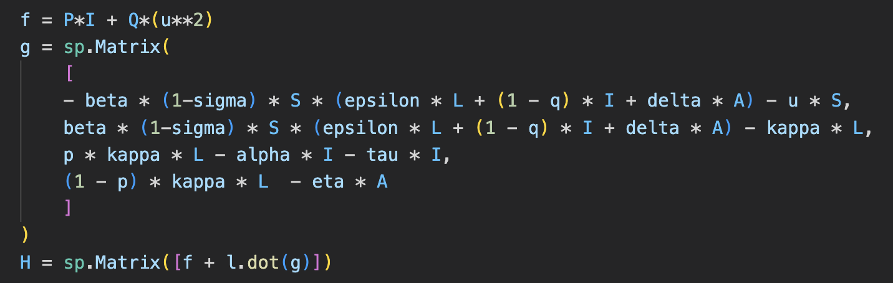
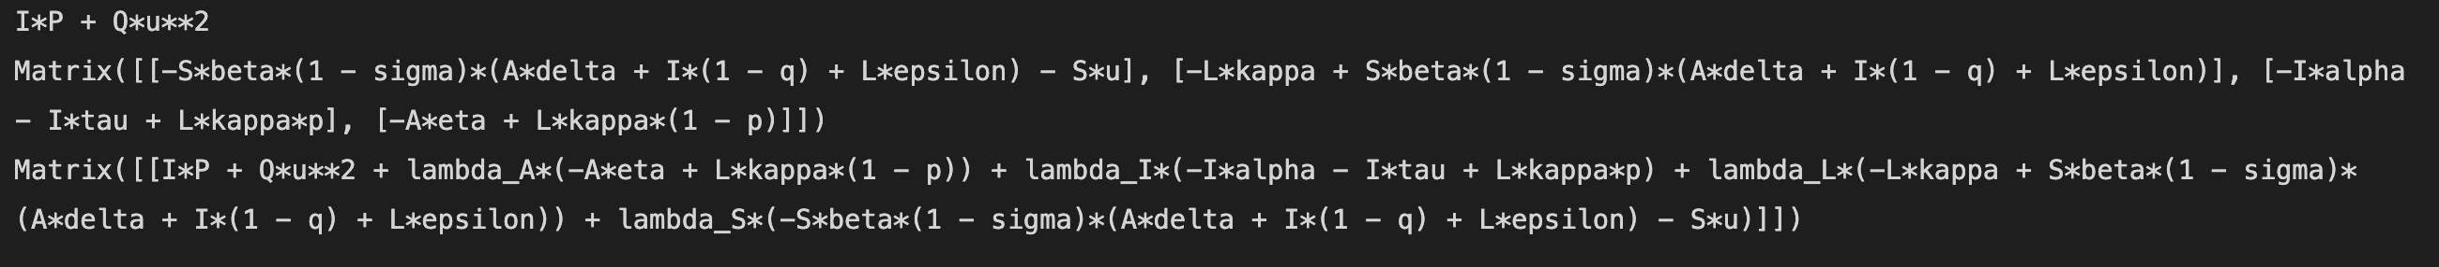
Implementation functions

Slide 8
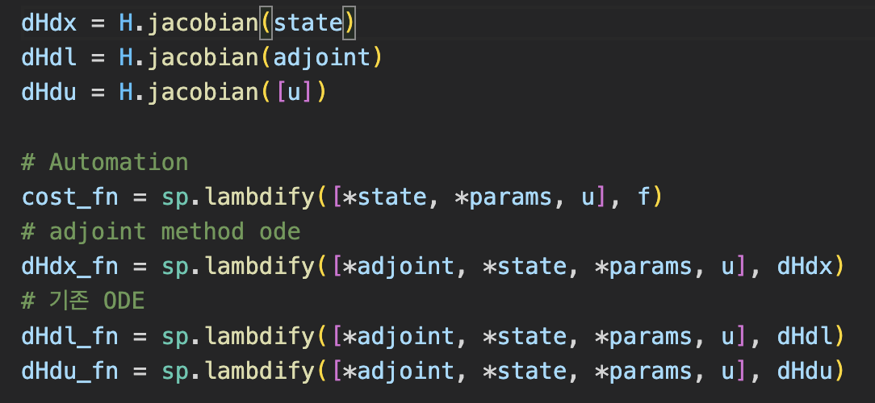
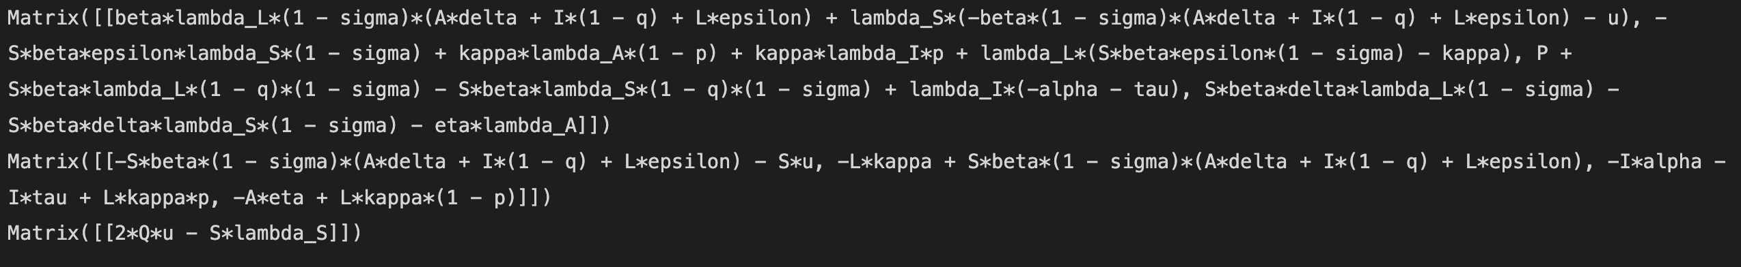
Implementation functions

Slide 9
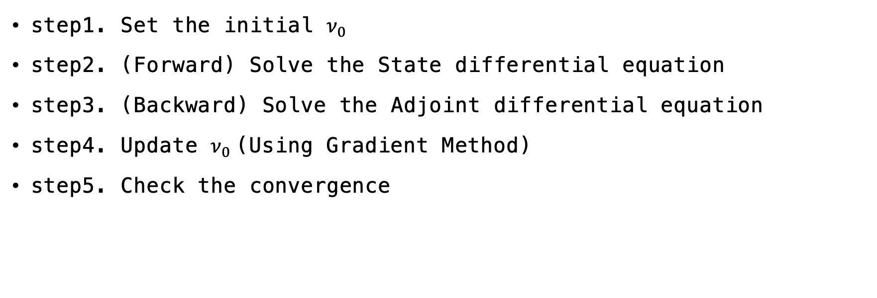
Simple gradient method
step1. Set the initial $ν_{0}$
step2. (Forward) Solve the State differential equation
step3. (Backward) Solve the Adjoint differential equation
step4. Update $ν_{0}$(Using Gradient Method)
step5. Check the convergence

Slide 10
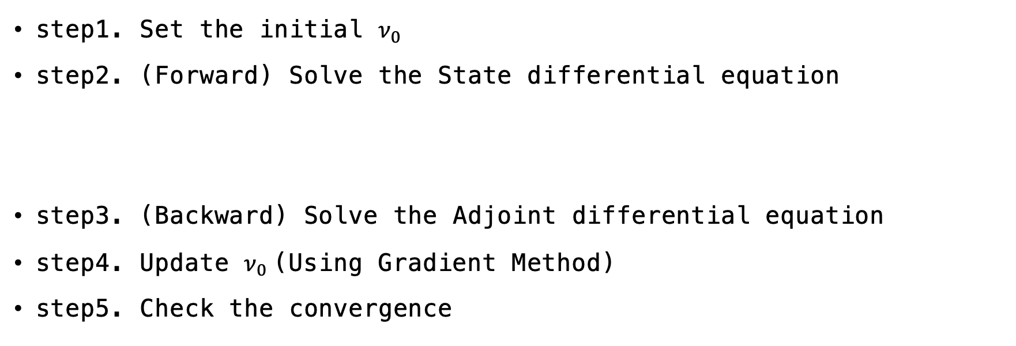
Simple gradient method
step1. Set the initial $ν_{0}$
step2. (Forward) Solve the State differential equation
step3. (Backward) Solve the Adjoint differential equation
step4. Update $ν_{0}$(Using Gradient Method)
step5. Check the convergence

Slide 11
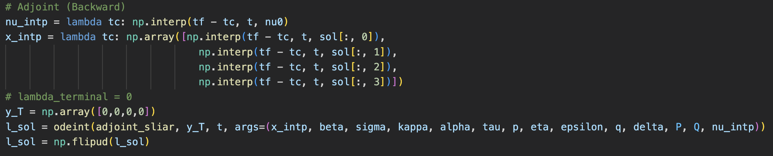

Simple gradient method
step1. Set the initial $ν_{0}$
step2. (Forward) Solve the State differential equation
step3. (Backward) Solve the Adjoint differential equation

Slide 12
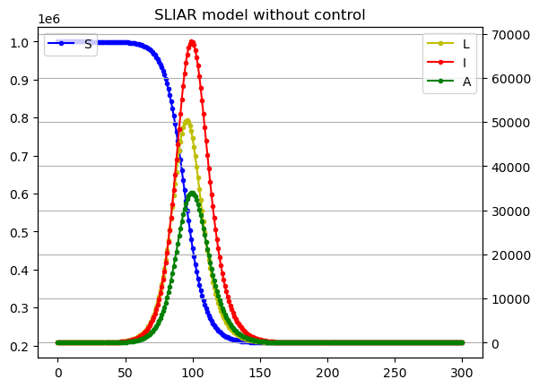
Result

Slide 13
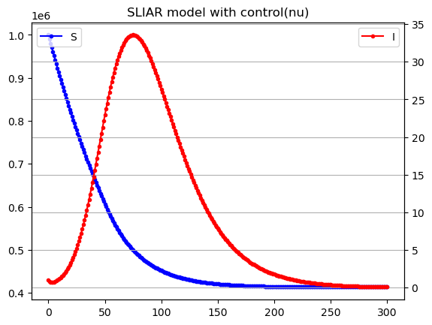
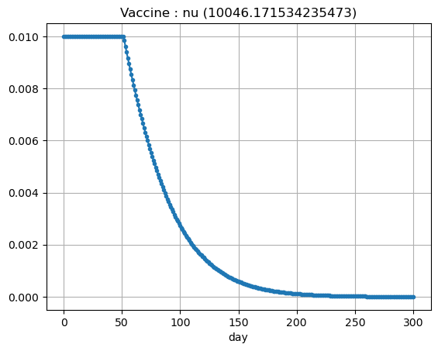
Result

